Slide 1
Development of master curricula for natural disasters risk management in Western Balkan countries
Middlesex University HEC
Dr Simon McCarthy
Flood Hazard Research Centre
Kick-off Meeting 15th December 2016
Project number: 573806-EPP-1-2016-1-RS-EPPKA2-CBHE-JP
"This project has been funded with support from the European Commission. This publication reflects the views only of the author, and the Commission cannot be held responsible for any use which may be made of the information contained therein"

Slide 2
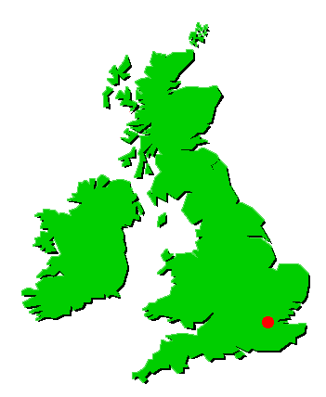
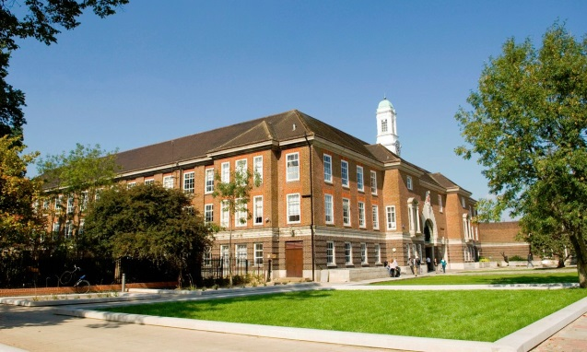
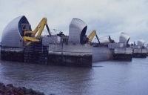
Location
Development of master curricula for natural disasters risk management in Western Balkan countries
Middlesex
University
FHRC
20 km
N
M25
Heathrow
Airport
River
Thames
Thames
Barrier
London
Gatwick Airport

Slide 3
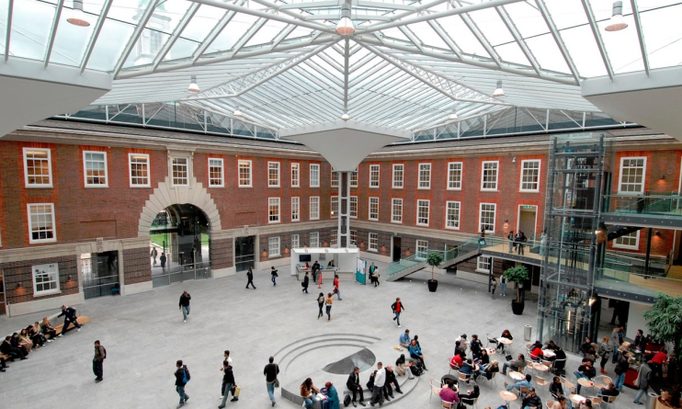
University
Development of master curricula for natural disasters risk management in Western Balkan countries
Established in 1878
Seven Schools: Science & Technology,
Health & Education,
Art & Design,
Business,
Law,
Media & Performing Arts,
Institute of Work Based Learning
Four campuses: London, Malta, Dubai, Mauritius
42,000 Students globally from 140 countries
1,800 staff globally
280 undergraduate and 170 graduate courses

Slide 4
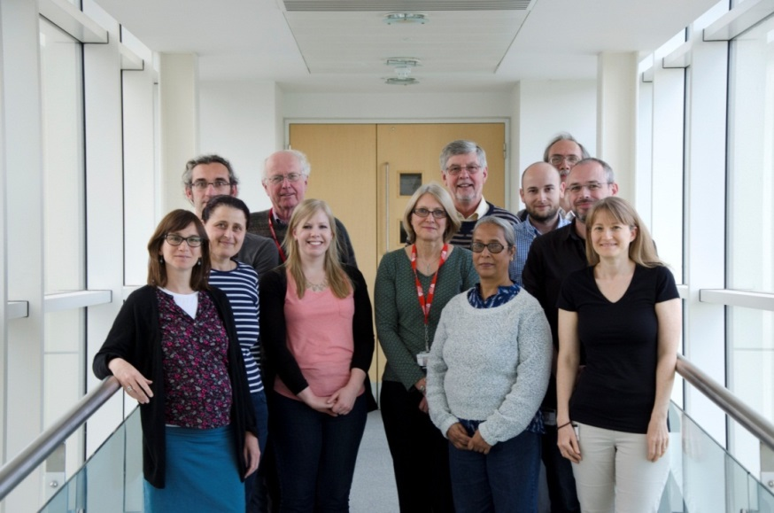
Flood Hazard Research Centre
Development of master curricula for natural disasters risk management in Western Balkan countries
Established 1970
Focus is on applied, academic and consultancy research
We put the people aspect into research about flood risk and water management
Small multi-disciplinary team of full time and part time researchers and research associates
Emphasis on social science
Plus Sally Priest
Mike Dawney

Slide 5
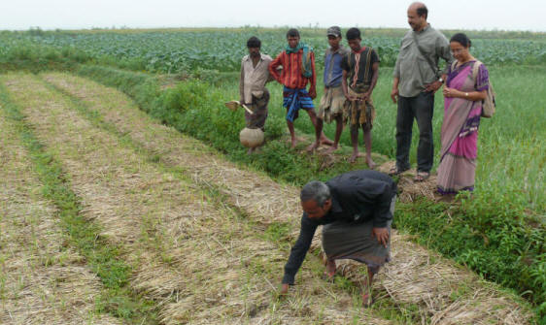
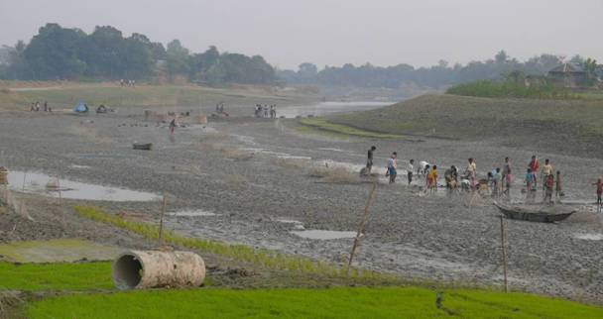
FHRC Asia office in Dhaka, Bangladesh
Development of master curricula for natural disasters risk management in Western Balkan countries
Over 20 years of experience
Research focus on: water and floodplain management, flood protection impacts, management of floodplain fisheries and wetlands, and adaptation to climate change
Input into MU Masters teaching programme; links with universities in Bangladesh and Nepal

Slide 6
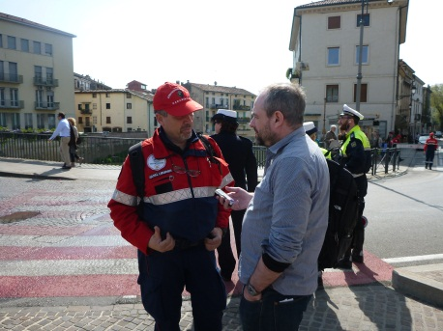
Research Funders
Development of master curricula for natural disasters risk management in Western Balkan countries
UK Government departments: Defra, Environment Agency, DoH, SEPA, OPW Ireland
European Commission/European Union
UK Research Councils
Local Authorities
Regulatory Bodies
Non Governmental Organisations e.g. Greenpeace,
International bodies: World Bank, UN, OECD
Overseas governments
Special interest groups

Slide 7
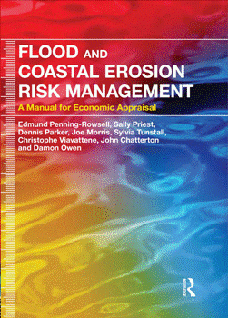
Input into UK policy and practice:
Development of master curricula for natural disasters risk management in Western Balkan countries
FHRC’s ‘Multi-coloured’ Manual for economic appraisal (UK industry standard for benefit assessments as part of flood and coastal erosion risk management appraisal)
The benefits of flood warning systems and behavioural response to warnings
Social aspects of flood risk management e.g. social justice, health impacts of floods

Slide 8
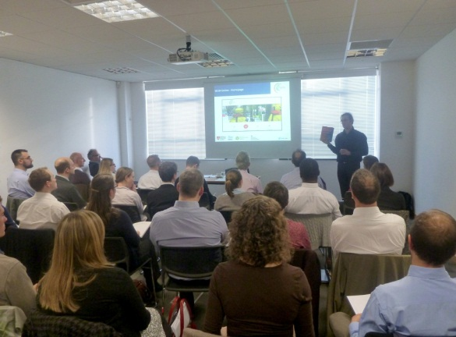
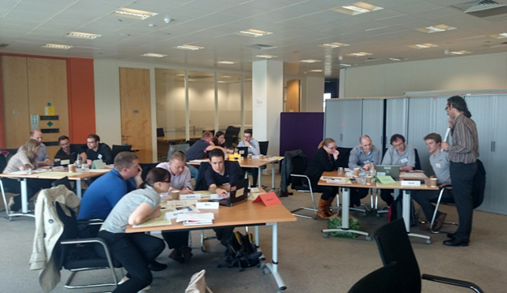
Teaching
Development of master curricula for natural disasters risk management in Western Balkan countries
PhD studentships,
Masters teaching programmes,
Continuing Professional Development training,
Visiting researchers/students
NatRisk: WP5 Quality Assurance and
Monitoring

